Slide 1

eXtreme Gradient Boosting Algorithm
XGBoost is a decision-tree-based ensemble Machine Learning algorithm that uses a gradient boosting framework

Slide 2
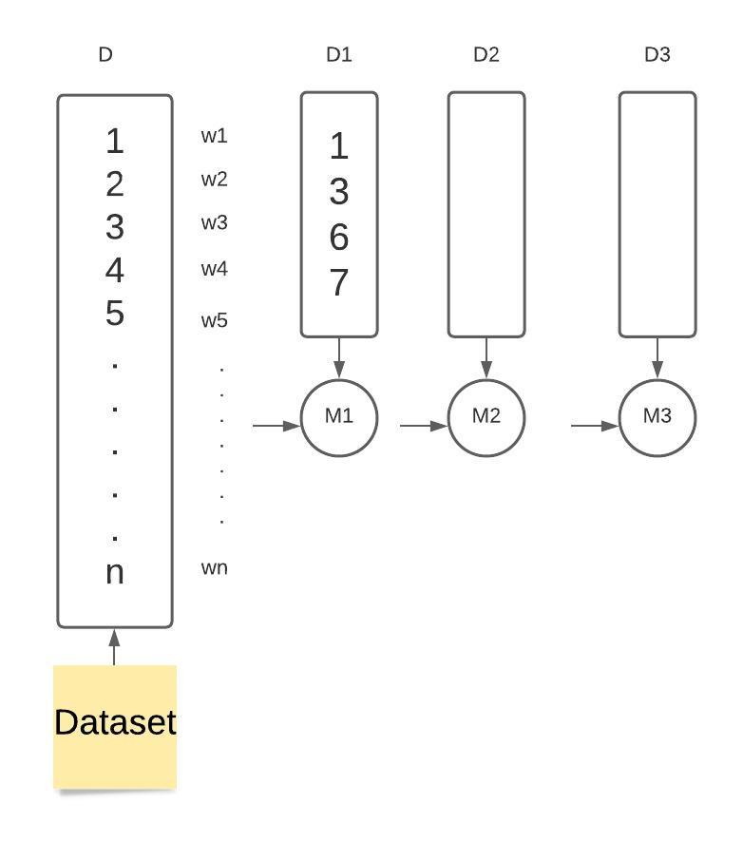
Boosting
Weights

Slide 3
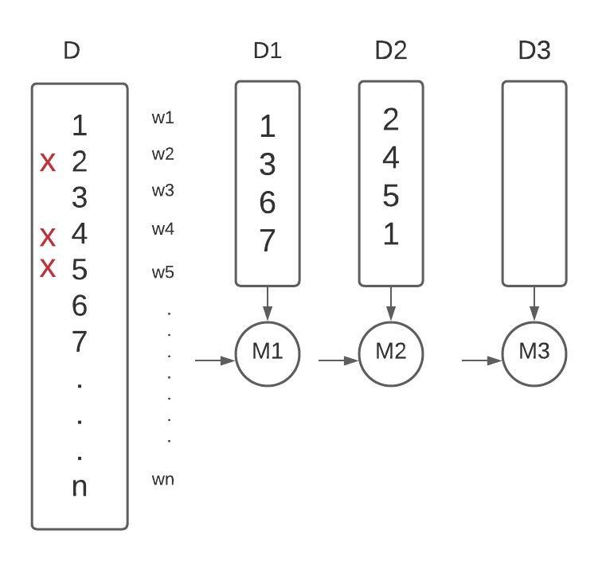

Slide 4
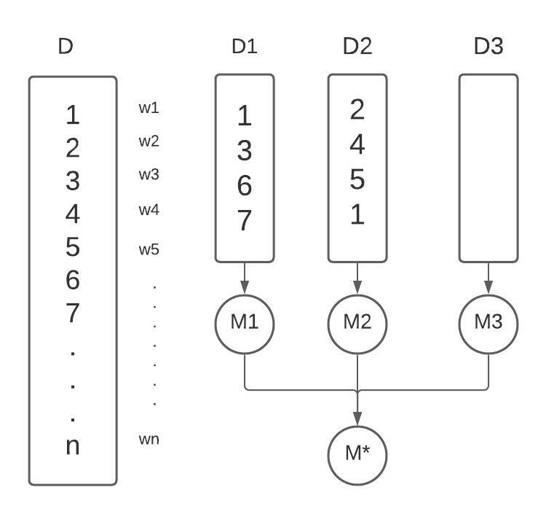

Slide 5
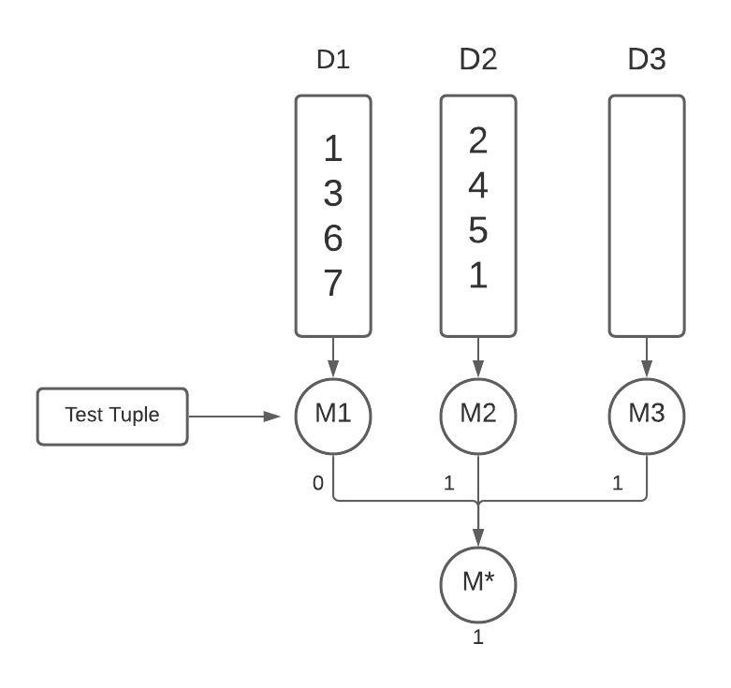

Slide 6
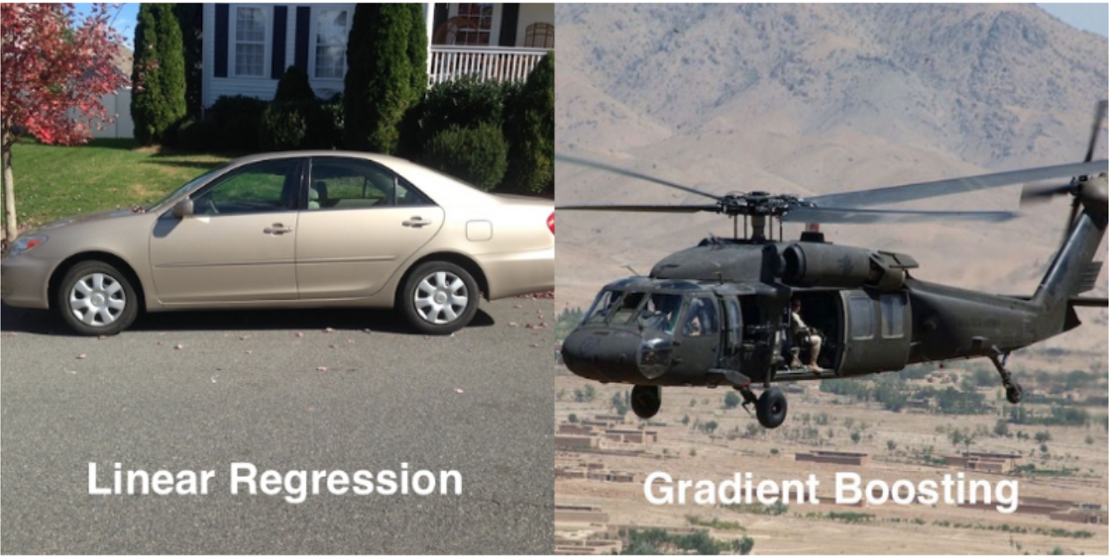
Gradient Boosting
Most popular algorithm used nowadays
Learning happens by optimising the loss

Slide 7
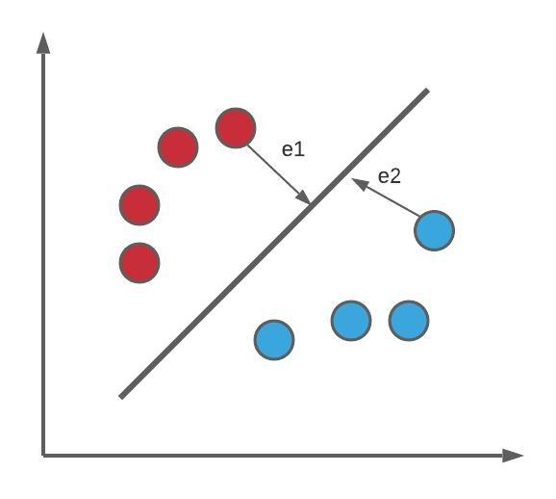
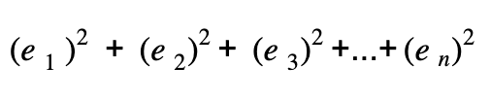
Optimisation of loss function

Slide 8

Gradient Boosting Algorithm
Loss Function
Additive Model
Learning Rate
Sequential Model

Slide 9
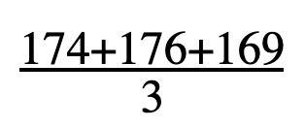
Average Height =
= 173
AGE | BMI | HEIGHT
21 | 24 | 174
22 | 26 | 176
24 | 28 | 169
AGE | BMI | HEIGHT | Predicted Values | Residuals
21 | 24 | 174 | 173 | 1
22 | 26 | 176 | 173 | 3
24 | 28 | 169 | 173 | -4

Slide 10
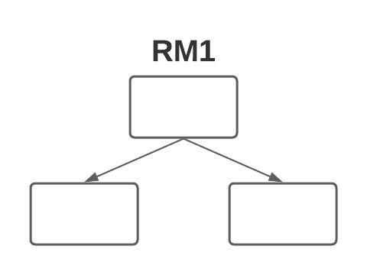
Target Column
Actual Values | Predicted Values | Residuals
174 | 173 | 1
176 | 173 | 3
169 | 173 | -4

Slide 11
Actual Values | New Predicted Values | Residuals | Predicted Residuals
174 | 174.15 | 0.15 | 1.5
176 | 176.25 | 0.25 | 2.5
169 | 168.97 | -0.03 | -3
Actual Values | Update Value | New Predicted Values
174 | 174 + (0.1*1.5) | 174.01
176 | 176 + (0.1*2.5) | 176.25
169 | 169 + (0.1*-3) | 168.97
Learning rate
0.1

Slide 12
Final Prediction = Base Value
+
(LR1 * Res Prediction 1) + (LR2 * Res Prediction 2) + ...
= 173 + (0.1*1.5) + (0.1*1.4) + ...

Slide 13
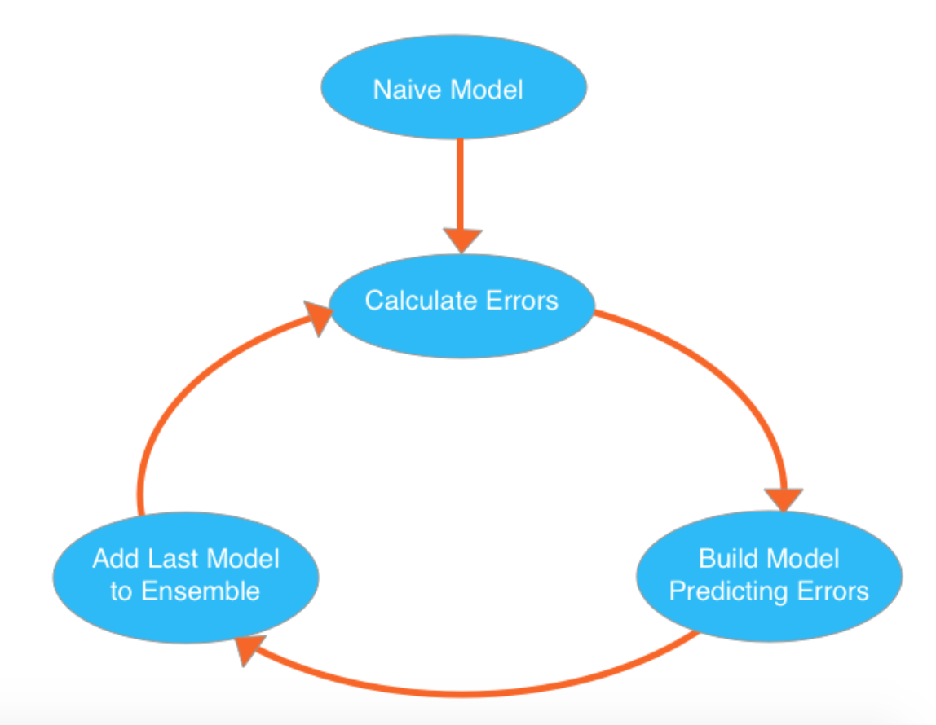

Slide 14

eXtreme Gradient Boosting
Tianqi Chen
Speed + Performance
Multiple Language support

Slide 15
Features of XGBoost
Speed | Performance
Cache Optimisation | Prevents Overfitting
Out of memory execution | Auto Pruning
Parallelisation | Missing Value Treatment

